Slide 1

Chess Streaming Service

Slide 2
GCP – used components

Slide 3
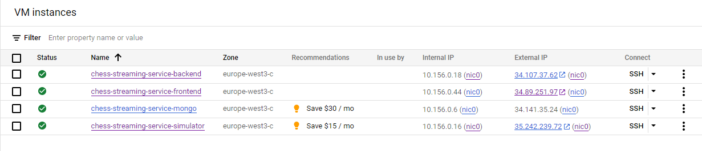
Cloud Compute Engine

Slide 4
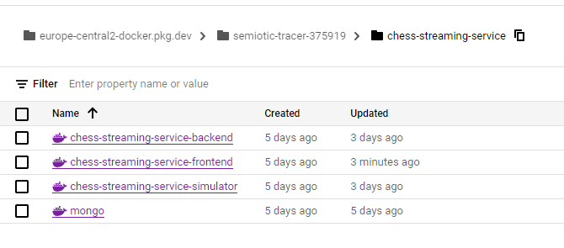
Artifact Registry

Slide 5
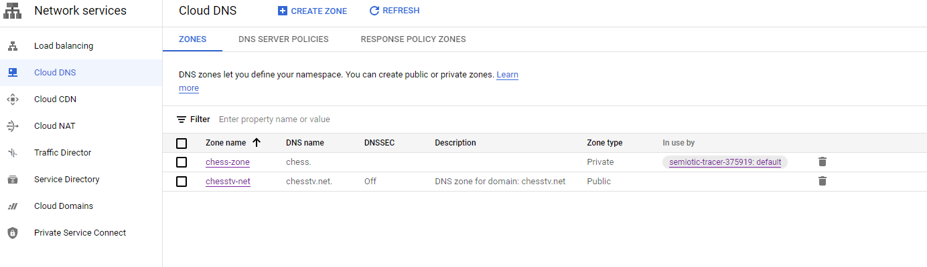
Cloud DNS

Slide 6
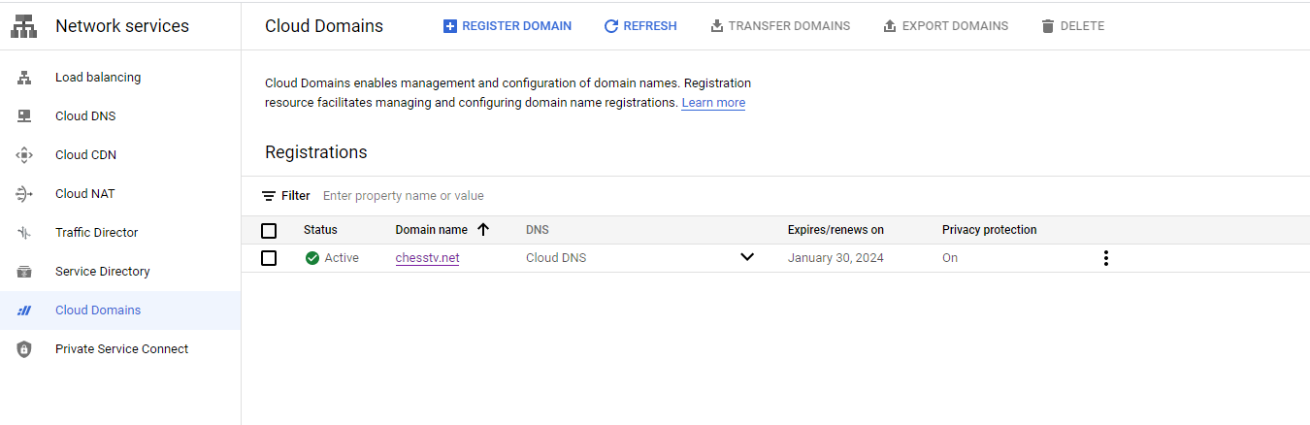
Dloud Domains

Slide 7
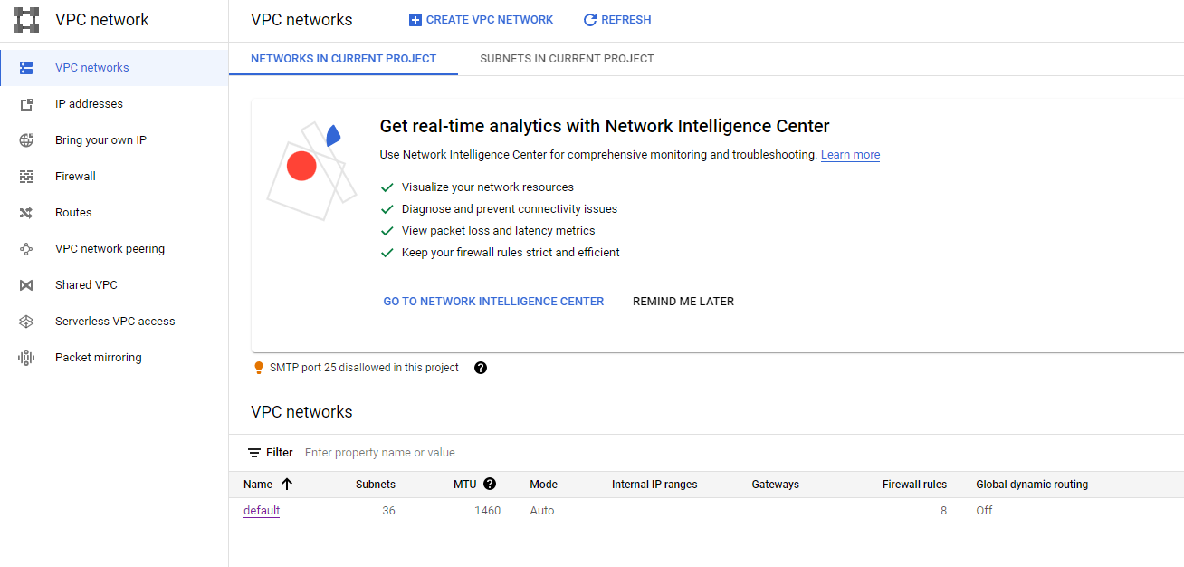
VPC

Slide 8
Live presentation

